Slide 1


Intermediate Python
Data with Numpy & Pandas

Slide 2
NumPy Arrays & Broadcasting
NumPy provides fast, vectorized numerical computation using array-based operations.
ndarray is the core NumPy data structure
Supports vectorized operations (no explicit loops)
Broadcasting enables operations across different shapes
Efficient memory layout (C-backed arrays)
Ideal for scientific & ML workloads
Notes:
Emphasize that broadcasting eliminates loops. Explain shape compatibility and how NumPy automatically expands smaller arrays when possible.

Slide 3
Code Example
import numpy as np
a = np.array([1, 2, 3])
b = np.array([10, 20, 30])
print(a + b) # element-wise addition
print(a * 2) # broadcasting scalar

Slide 4
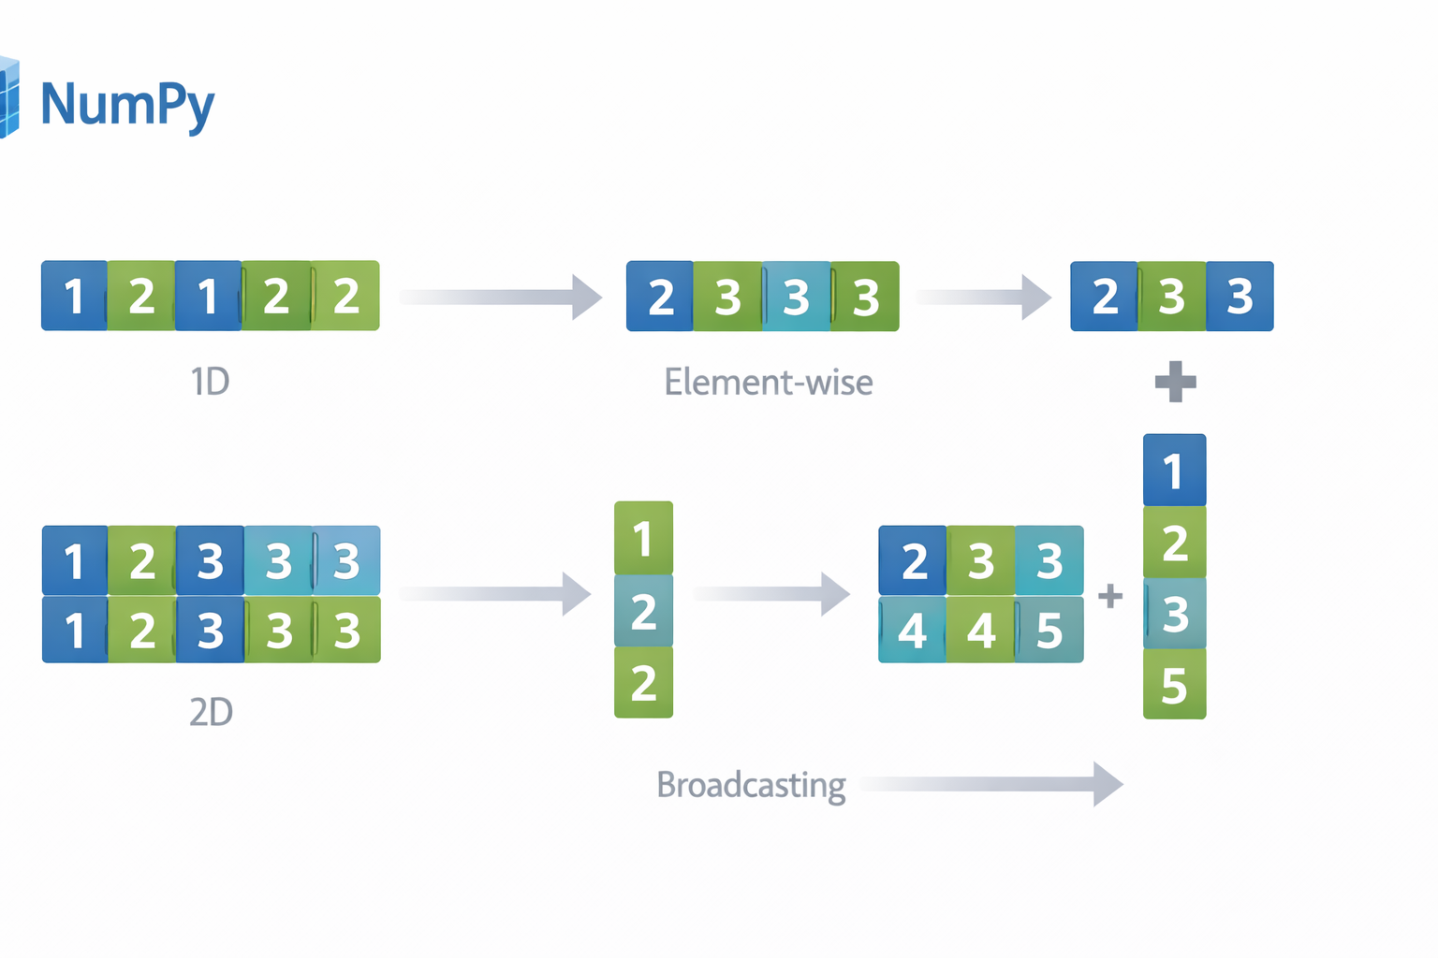

Slide 5
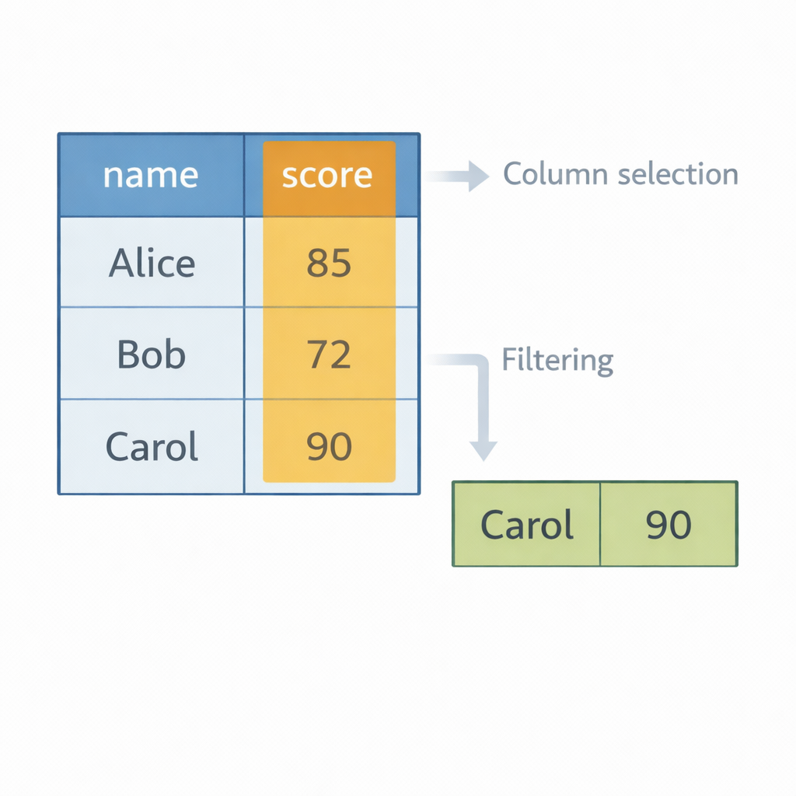
Pandas Series & DataFrames
Pandas structures data into labeled Series and DataFrames for analysis.
Series = 1D labeled data
DataFrame = 2D tabular data structure
Built on top of NumPy
Supports indexing, filtering, slicing
Ideal for structured datasets (CSV, Excel, SQL)
Notes:
Explain how Pandas adds labels on top of NumPy arrays, making data analysis intuitive and readable.

Slide 6
Code Example
import pandas as pd
data = {
"name": ["Aina", "Ali", "Mira"],
"score": [85, 70, 92]
}
df = pd.DataFrame(data)
print(df["score"].mean())

Slide 7
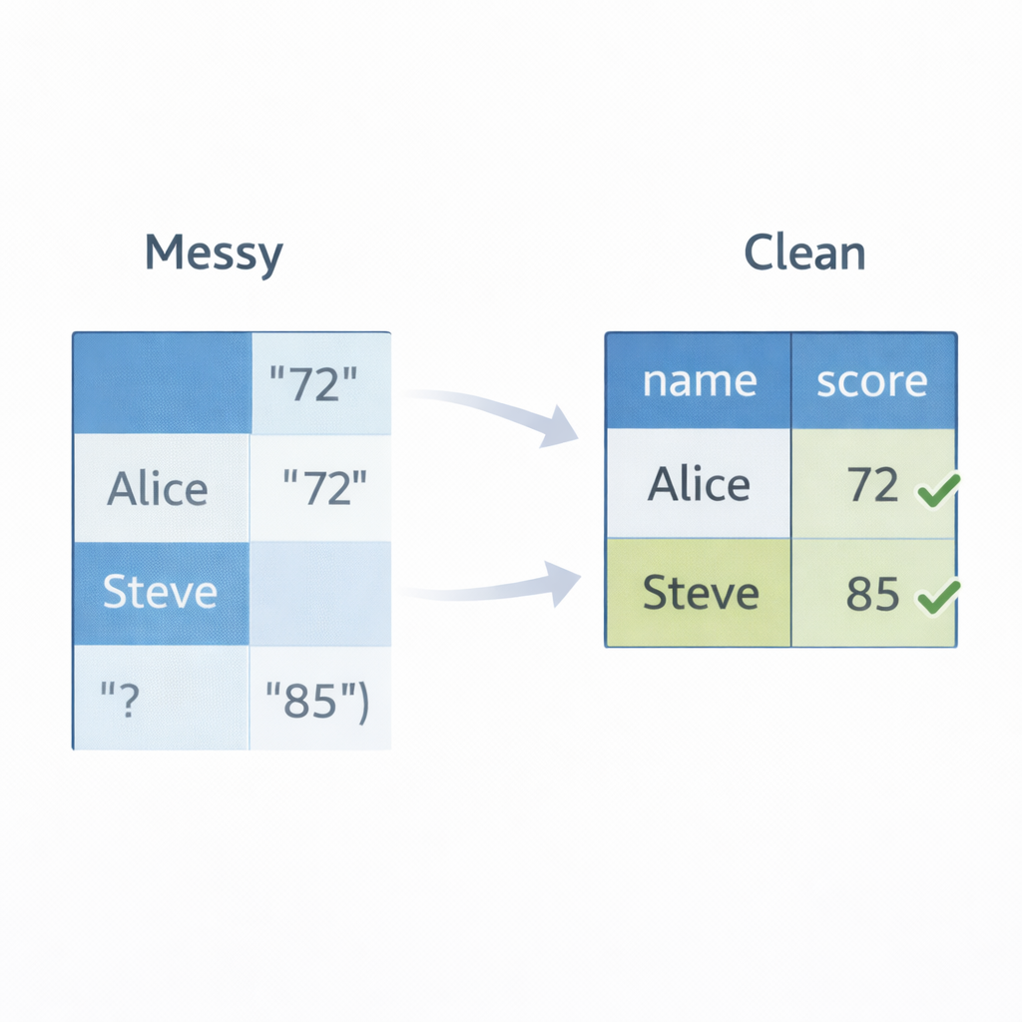
Data Cleaning
Data cleaning prepares raw data for reliable analysis.
Handle missing values (isna(), fillna())
Remove duplicates
Type conversion (astype())
Rename columns
Filter invalid rows
Notes:
Stress that real-world data is rarely clean. Cleaning is often 70% of data work.

Slide 8
Code Example
df["score"] = df["score"].fillna(0)
df = df.drop_duplicates()
df["score"] = df["score"].astype(int)

Slide 9
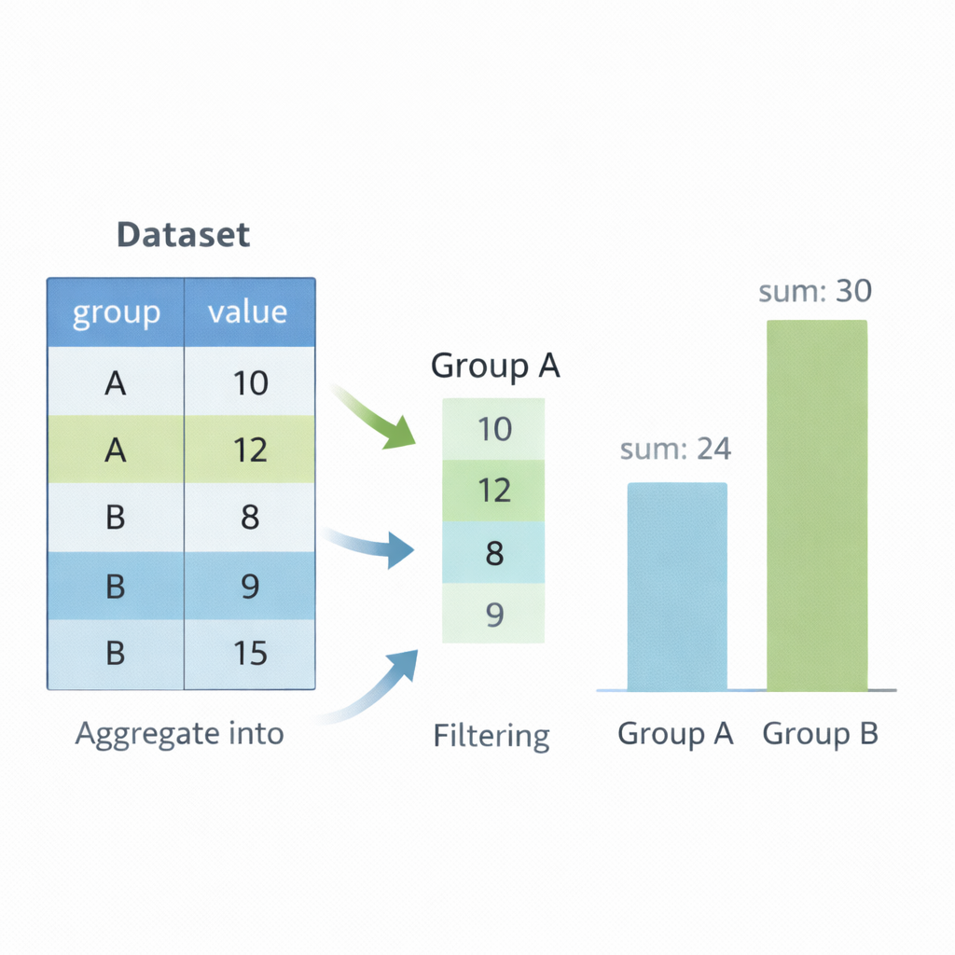
Grouping & Aggregation
Grouping allows summarizing data across categories.
groupby() splits data into groups
Apply aggregation: mean, sum, count
Enables business insights
Supports multiple aggregations
Essential for reporting & analytics
Image Prompt
Speaker Notes
Notes:
Explain “split–apply–combine” model. Show how grouping transforms raw data into insights.

Slide 10
Code Example
df = pd.DataFrame({
"class": ["A", "A", "B", "B"],
"score": [80, 90, 70, 85]
})
grouped = df.groupby("class")["score"].mean()
print(grouped)

Slide 11
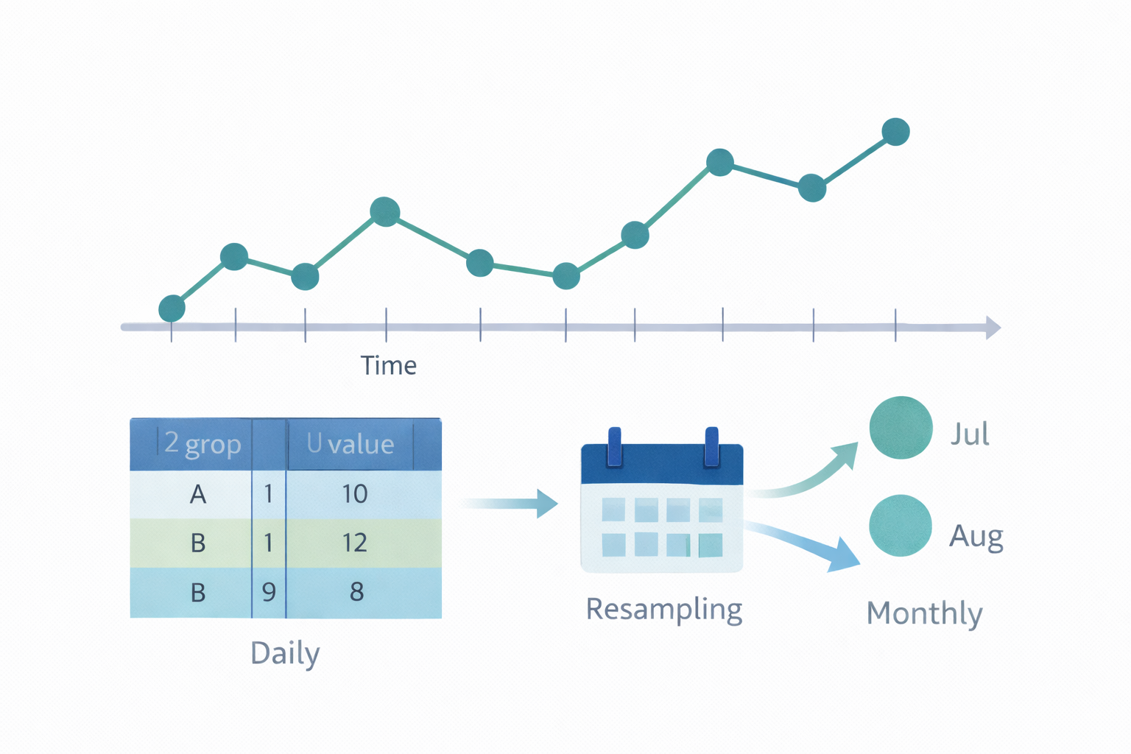
Time Series
Time series analysis handles data indexed by dates and time.
Use datetime indexing
Resampling (daily → monthly)
Rolling windows (moving average)
Trend detection
Widely used in finance & forecasting
Notes:
Highlight real-world use cases: financial markets, IoT data, analytics dashboards.

Slide 12
Code Example
df["date"] = pd.to_datetime(df["date"])
df.set_index("date", inplace=True)
monthly = df.resample("M").mean()
print(monthly)

